Slide 1


Welcome you all
JAVA PROGRAMMING
DAY : 4
D.Sakthivel
Assistant Professor & Trainer,
KGiSL Micro College
KGiSL Campus, Coimbatore – 641 035.

Slide 2
Day 4
Constructors
Types of Constructors
Java Default Constructor
Parameterized Constructor
Constructor Overloading
Java Copy Constructor

Slide 3
Constructors in Java
In Java, a constructor is a block of codes similar to the method.
It is called when an instance of the class is created.
At the time of calling constructor, memory for the object is allocated in the memory.
It is a special type of method which is used to initialize the object.

Slide 4
Constructors in Java
Every time an object is created using the new() keyword, at least one constructor is called.
It calls a default constructor if there is no constructor available in the class.
In such case, Java compiler provides a default constructor by default.
There are two types of constructors in Java:
no-arg constructor, and parameterized constructor.
Note: It is called constructor because it constructs the values at the time of object creation. It is not necessary to write a constructor for a class. It is because java compiler creates a default constructor if your class doesn't have any.

Slide 5

Rules for creating Java constructor
There are two rules defined for the constructor.
Constructor name must be the same as its class name
A Constructor must have no explicit return type
A Java constructor cannot be abstract, static, final, and synchronized

Slide 6
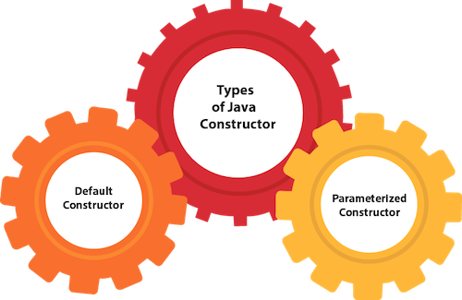
Types of Java constructors
There are two types of constructors in Java:
Default constructor (no-arg constructor)
Parameterized constructor

Slide 7
Java Default Constructor
A constructor is called "Default Constructor" when it doesn't have any parameter.
Syntax of default constructor:
<class_name>(){ }
EXAMPLE:
//Java Program to create and call a default constructor
class Bike1{
//creating a default constructor
Bike1(){System.out.println("Bike is created");}
//main method
public static void main(String args[]){
//calling a default constructor
Bike1 b=new Bike1();
}
}

Slide 8
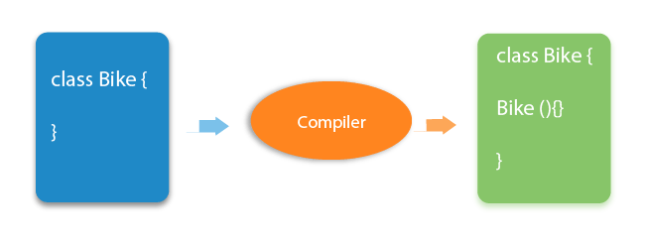
Java Default Constructor
What is the purpose of a default constructor?
The default constructor is used to provide the default values to the object like 0, null, etc., depending on the type.

Slide 9

/Let us see another example of default constructor
//which displays the default values
class Student3{
int id;
String name;
//method to display the value of id and name
void display(){System.out.println(id+" "+name);}
public static void main(String args[]){
//creating objects
Student3 s1=new Student3();
Student3 s2=new Student3();
//displaying values of the object
s1.display();
s2.display();
}
}

Slide 10
Java Parameterized Constructor
A constructor which has a specific number of parameters is called a parameterized constructor.
Why use the parameterized constructor?
The parameterized constructor is used to provide different values to distinct objects.
However, you can provide the same values also.

Slide 11
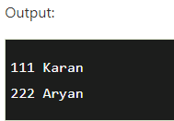
/Java Program to demonstrate the use of the parameterized constructor.
class Student4{
int id;
String name;
//creating a parameterized constructor
Student4(int i,String n){
id = i;
name = n;
}
//method to display the values
void display(){System.out.println(id+" "+name);}
public static void main(String args[]){
//creating objects and passing values
Student4 s1 = new Student4(111,"Karan");
Student4 s2 = new Student4(222,"Aryan");
//calling method to display the values of object
s1.display();
s2.display();
}
}

Slide 12
Constructor Overloading in Java
In Java, a constructor is just like a method but without return type.
It can also be overloaded like Java methods.
Constructor overloading in Java is a technique of having more than one constructor with different parameter lists.
They are arranged in a way that each constructor performs a different task.
They are differentiated by the compiler by the number of parameters in the list and their types.

Slide 13
Constructor Overloading in Java
//Java program to overload constructors
class Student5{
int id;
String name;
int age;
//creating two arg constructor
Student5(int i,String n){
id = i;
name = n;
}
//creating three arg constructor
Student5(int i,String n,int a){
id = i;
name = n;
age=a;
}

Slide 14
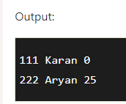
Constructor Overloading in Java
void display(){System.out.println(id+" "+name+" "+age);}
public static void main(String args[]){
Student5 s1 = new Student5(111,"Karan");
Student5 s2 = new Student5(222,"Aryan",25);
s1.display();
s2.display();
}
}

Slide 15
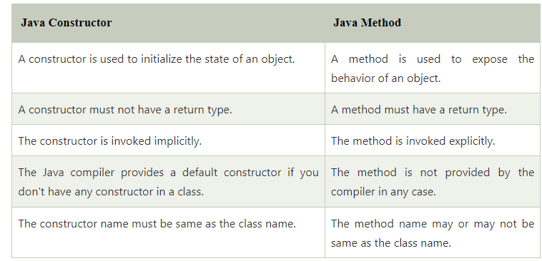
Constructor Overloading in Java

Slide 16
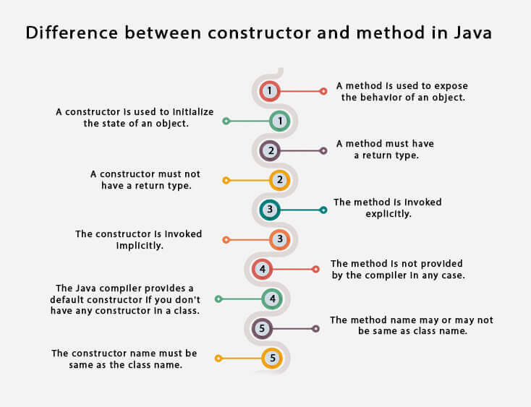
Constructor Overloading in Java

Slide 17
Java Copy Constructor
There is no copy constructor in Java. However, we can copy the values from one object to another like copy constructor in C++.
There are many ways to copy the values of one object into another in Java.
They are:
By constructor
By assigning the values of one object into another
By clone() method of Object class

Slide 18
Java Copy Constructor
/Java program to initialize the values from one object to another object.
class Student6{
int id;
String name;
//constructor to initialize integer and string
Student6(int i,String n){
id = i;
name = n;
}
//constructor to initialize another object
Student6(Student6 s){
id = s.id;
name =s.name;
}

Slide 19
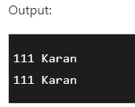
Java Copy Constructor
/void display(){System.out.println(id+" "+name);}
public static void main(String args[]){
Student6 s1 = new Student6(111,"Karan");
Student6 s2 = new Student6(s1);
s1.display();
s2.display();
}
}

Slide 20
Copying values without constructor
We can copy the values of one object into another by assigning the objects values to another object. I
n this case, there is no need to create the constructor.
class Student7{
int id;
String name;
Student7(int i,String n){
id = i;
name = n;
}
Student7(){}
void display(){System.out.println(id+" "+name);}

Slide 21
Copying values without constructor
public static void main(String args[]){
Student7 s1 = new Student7(111,"Karan");
Student7 s2 = new Student7();
s2.id=s1.id;
s2.name=s1.name;
s1.display();
s2.display();
}
}

Slide 22
Does constructor return any value?
Yes, it is the current class instance (You cannot use return type yet it returns a value).
Can constructor perform other tasks instead of initialization?
Yes, like object creation, starting a thread, calling a method, etc. You can perform any operation in the constructor as you perform in the method.
Is there Constructor class in Java?
Yes.
What is the purpose of Constructor class?
Java provides a Constructor class which can be used to get the internal information of a constructor in the class. It is found in the java.lang.reflect package.

Slide 23



Thank You

